Slide 1
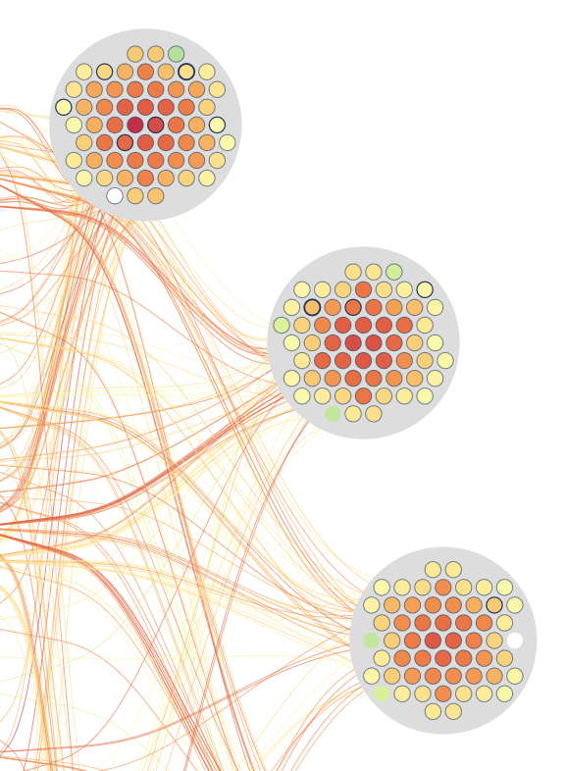
JobViewer-TimeArc
Job monitoring visualization

Slide 2
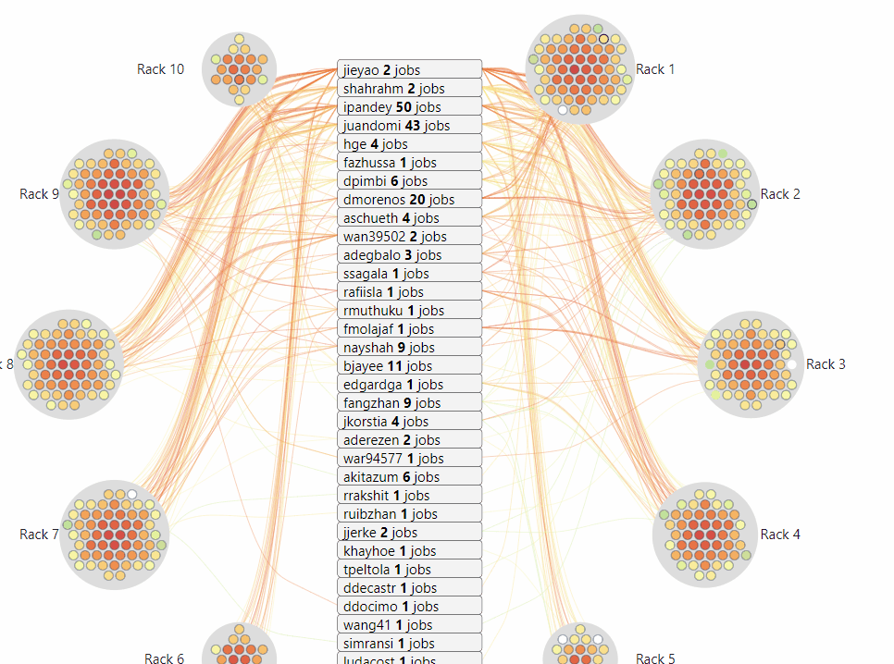
JobViewer
Compute
User
Link
Color by metrics value (e.g: Temperature, Fan speed, etc.)
Border thickness: number of user utilizing the node

Slide 3
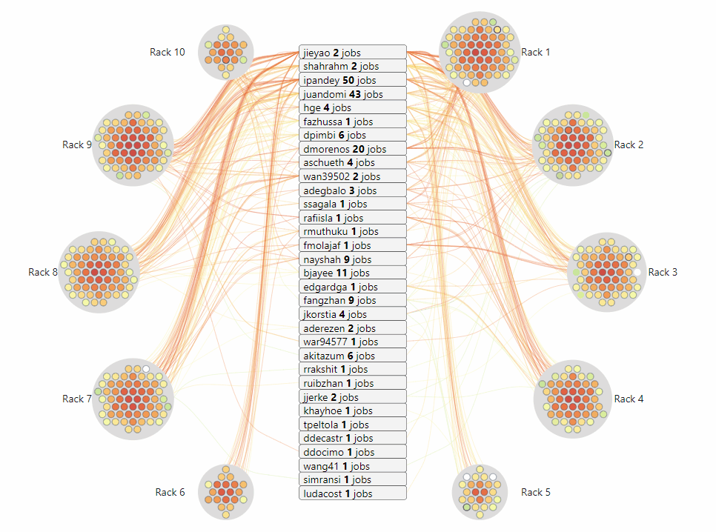
JobViewer
Compute
User
Link
<user_name> <#jobs> jobs
#job: running job the snapshot

Slide 4
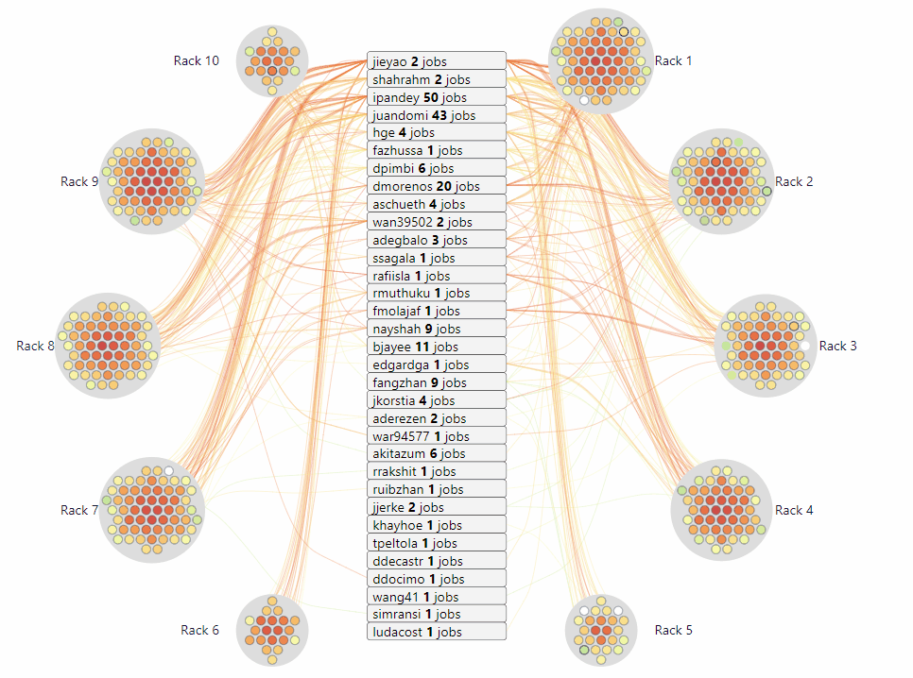
JobViewer
Compute
User
Link
Connect between the user and compute when that user has a running job on that compute

Slide 5
JobViewer
Simulation
https://idatavisualizationlab.github.io/HPCC/spiralLayout/index.html
Realtime
https://idatavisualizationlab.github.io/HPCC/spiralLayout/index.html?mode=realTime

Slide 6
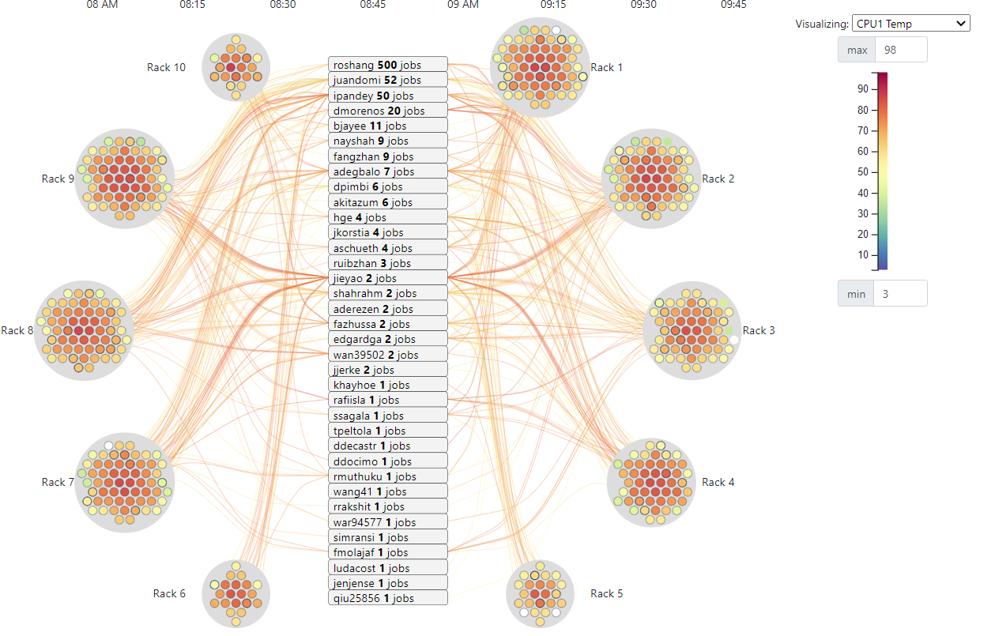
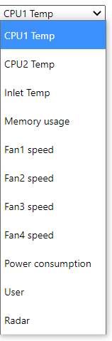
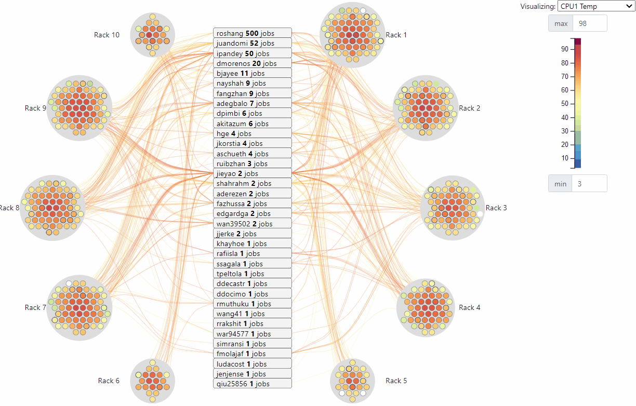
JobViewer

Slide 7
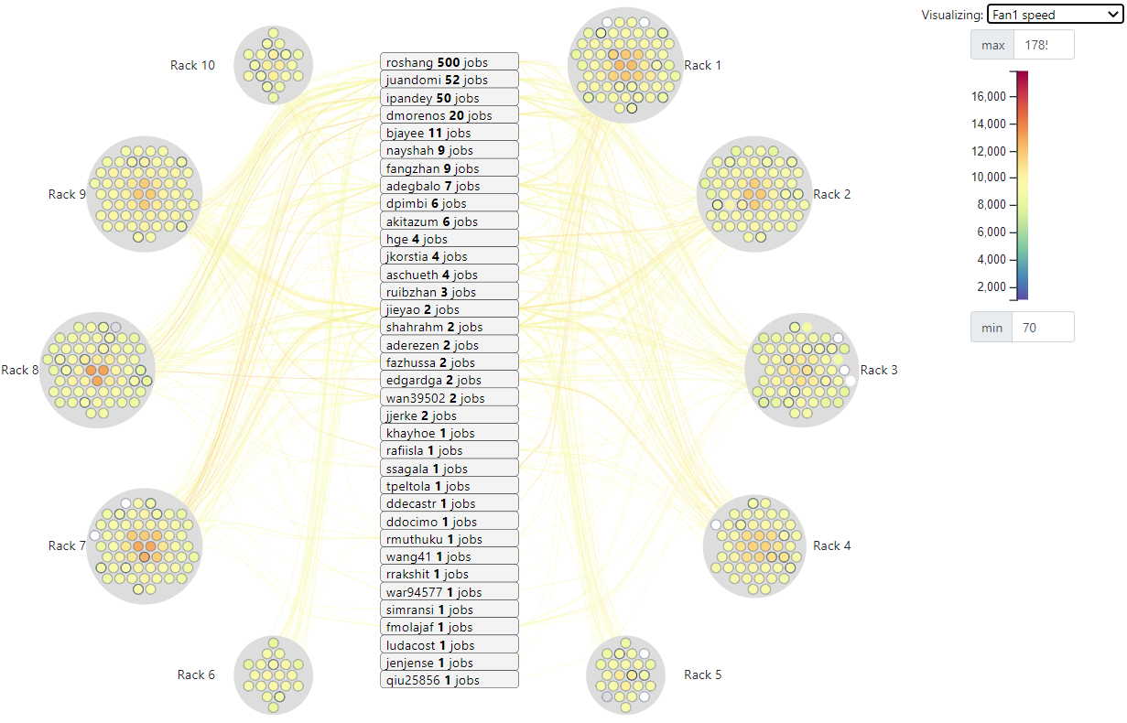
JobViewer
10.101.8.47
Fan speed of 10.101.8.47 and 10.101.5.14 are out of range
10.101.5.14

Slide 8
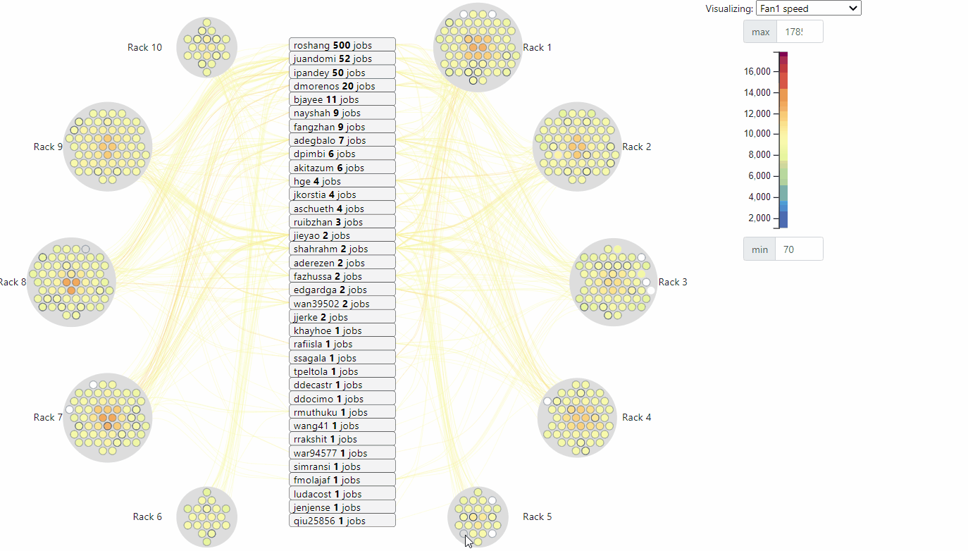
JobViewer
10.101.8.47
10.101.5.14

Slide 9
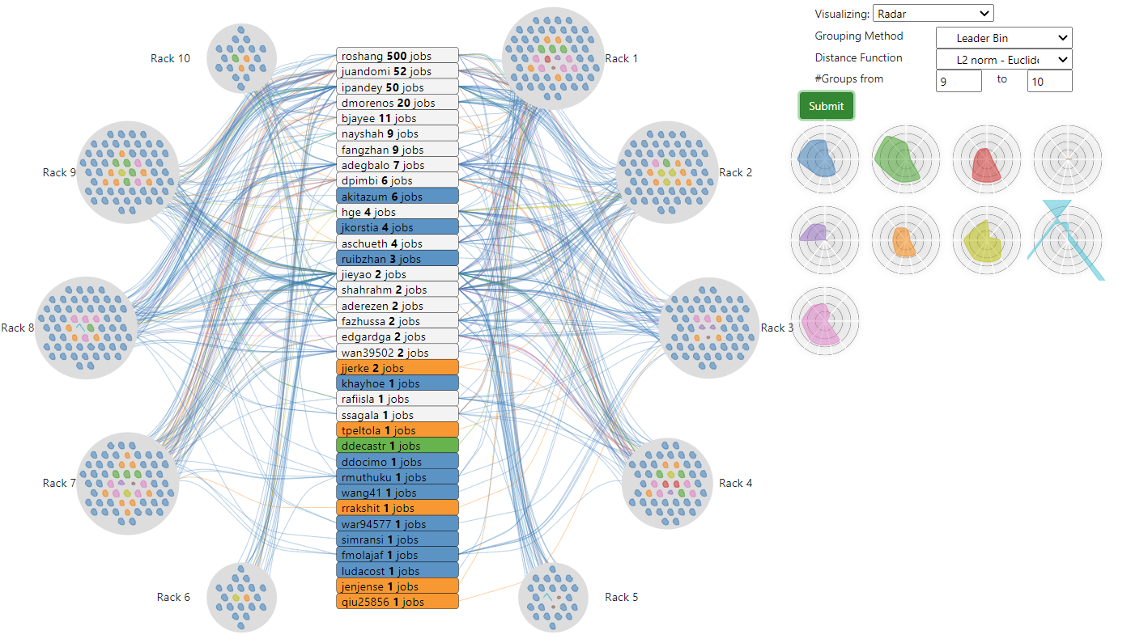
JobViewer

Slide 10
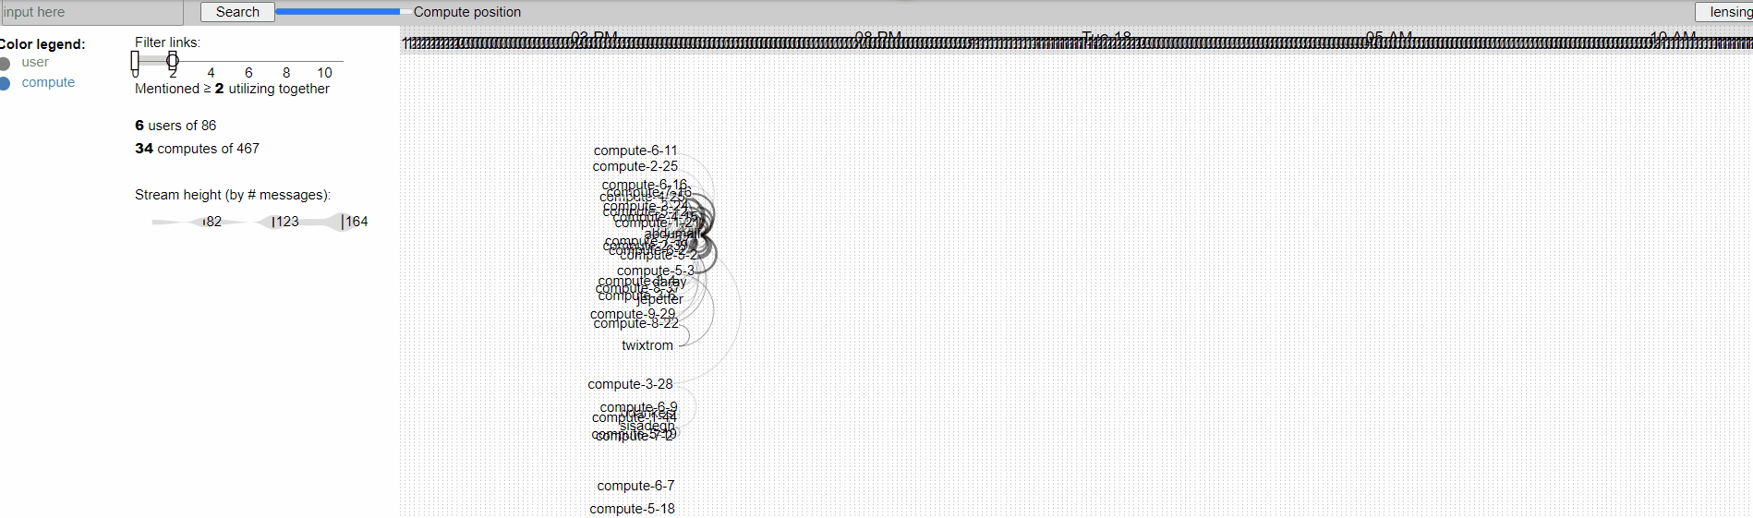
TimeArc
https://idatavisualizationlab.github.io/HPCC/TimeArc/

Slide 11
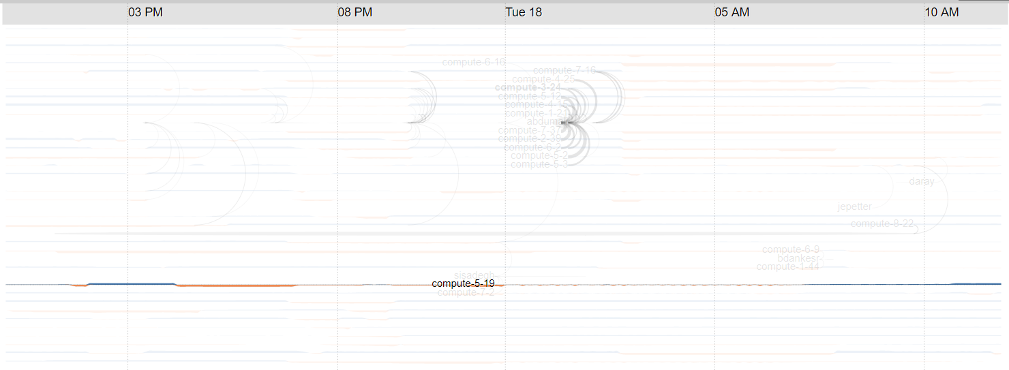
TimeArc
Compute
User
Link
Area chart display the CPU1 temperature:
Above 60
Below 60

Slide 12
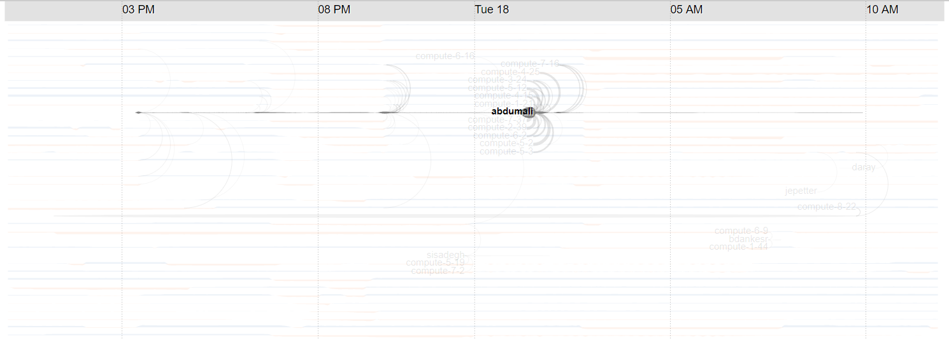
TimeArc
Compute
User
Link
User stream height represent # jobs start running

Slide 13
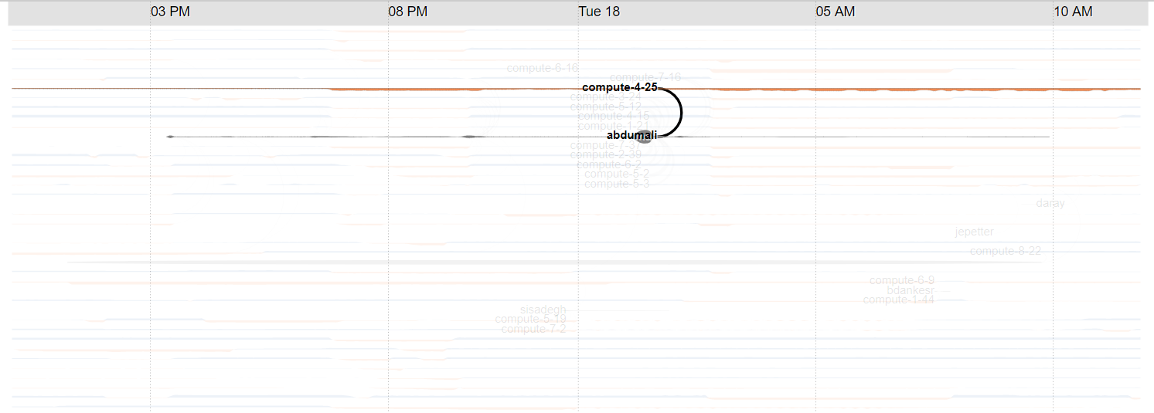
TimeArc
Compute
User
Link
Link show number of job started at a time

Slide 14
JobViewer
Compute
User
Link
Link show number of job started at a time

Slide 15
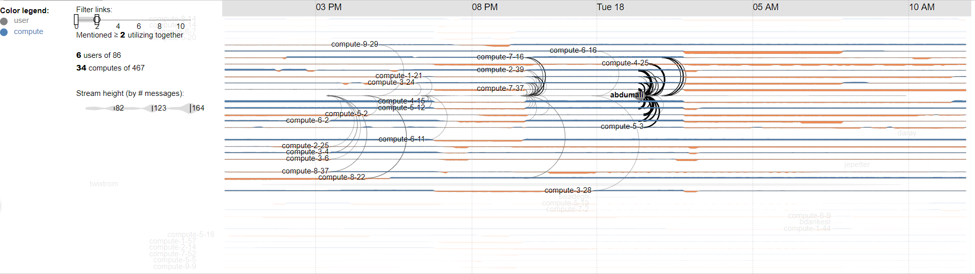
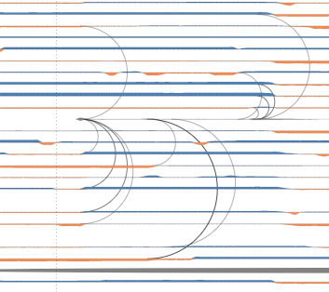
TimeArc

Slide 16
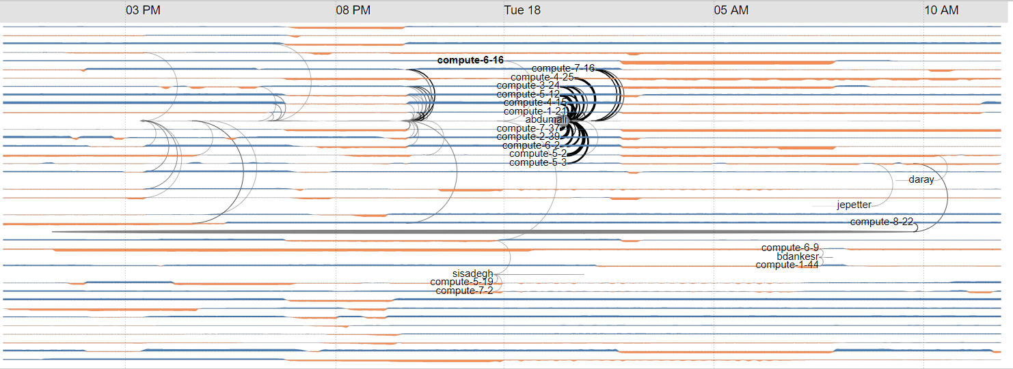
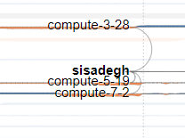
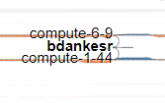
TimeArc

